Slide 1

PYTHON PROGRAMMING & DATA SCIENCE

Slide 2
Exploratory Data Analysis(EDA)
Exploratory Data Analysis (EDA) is the first step in data analysis process .
Exploratory Data Analysis (EDA) is developed by “John Tukey” in the 1970s.
What is Exploratory Data Analysis ?
Exploratory Data Analysis or (EDA) is understanding the data sets by summarizing their main characteristics often plotting them visually.
This step is very important especially when we arrive at modeling the data in order to apply Machine learning.
Plotting in EDA consists of Histograms, Box plot, Scatter plot and many more.
It often takes much time to explore the data.

Slide 3
Exploratory Data Analysis(EDA)
Exploratory Data Analysis helps us to –
To give insight into a data set.
Understand the underlying structure.
Extract important parameters and relationships that hold between them.
Test underlying assumptions
How to perform Exploratory Data Analysis ?
There is no one method or common methods in order to perform EDA.
EDA is performed depends on the dataset that we are working.

Slide 4
Exploratory Data Analysis(EDA)
Example:
Consider a data set related to car.
This dataset contains more of 10, 000 rows and more than 10 columns which contains features of the car such as Engine Fuel Type, Engine HP, Transmission Type, highway MPG, city MPG and many more.
explore the data and make it ready for modeling.

Slide 5
Exploratory Data Analysis(EDA)
data exploring:
1. Importing the required libraries for EDA
import pandas as pd
import numpy as np
import seaborn as sns
import matplotlib.pyplot as plt
%matplotlib inline
sns.set(color_codes=True)

Slide 6
Exploratory Data Analysis(EDA)
data exploring:
2. Loading the data into the data frame.
Loading the data into the pandas data frame is certainly one of the most important steps in EDA.
The value from the data set is comma-separated. So read the CSV into a data frame
pandas data frame is used to read the data.

Slide 7
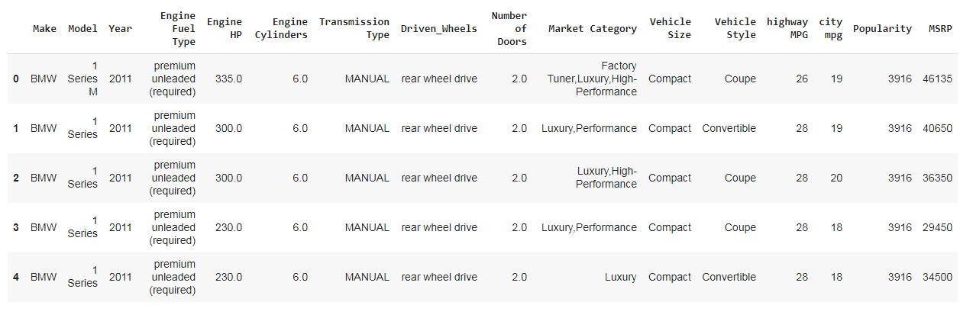
Exploratory Data Analysis(EDA)
data exploring:
df = pd.read_csv("data.csv")
df.head(5) # To display the top 5 rows

Slide 8
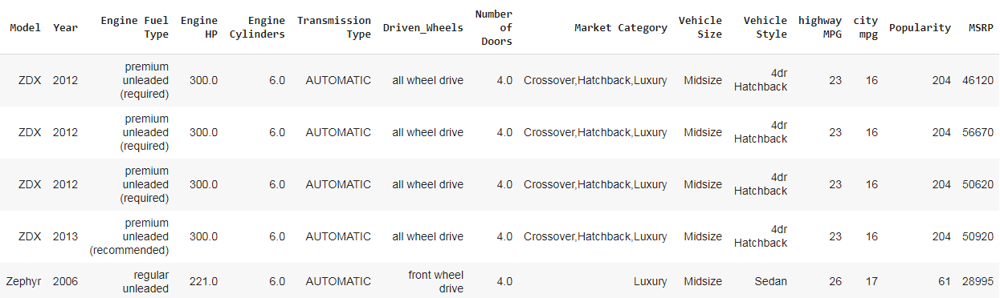
Exploratory Data Analysis(EDA)
data exploring:
df.tail(5) # To display the botton 5 rows

Slide 9
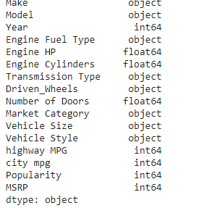
Exploratory Data Analysis(EDA)
data exploring:
3. Checking the types of data
df.dtypes
Here we check for the datatypes because sometimes the MSRP or the price of the car would be stored as a string, if in that case, we have to convert that string to the integer data only then we can plot the data via a graph.
Here, in this case, the data is already in integer format so nothing to worry.

Slide 10
Exploratory Data Analysis(EDA)
data exploring:
4. Dropping irrelevant columns.
This step is certainly needed in every EDA because sometimes there would be many columns that we never use. In such cases drop the irrelevant columns.
In this case, the columns such as Engine Fuel Type, Market Category, Vehicle style, Popularity, Number of doors, Vehicle Size doesn't make any sense so just drop

Slide 11
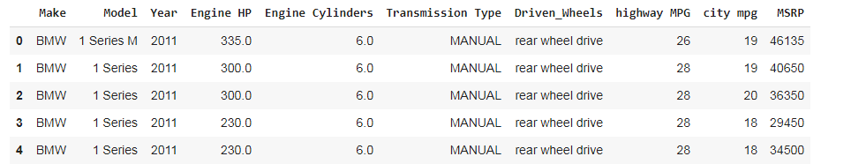
Exploratory Data Analysis(EDA)
data exploring:
df = df.drop(['Engine Fuel Type', 'Market Category', 'Vehicle Style', 'Popularity', 'Number of Doors', 'Vehicle Size'], axis=1)
df.head(5)

Slide 12
Exploratory Data Analysis(EDA)
data exploring:
5. Renaming the columns
In this instance, most of the column names are very confusing to read, so rename their column names.
This is a good approach it improves the readability of the data set.
df = df.rename(columns={"Engine HP": "HP", "Engine Cylinders": "Cylinders", "Transmission Type": "Transmission", "Driven_Wheels": "Drive Mode","highway MPG": "MPG-H", "city mpg": "MPG-C", "MSRP": "Price" })

Slide 13
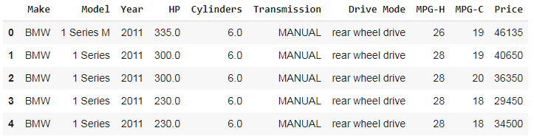
Exploratory Data Analysis(EDA)
data exploring:
df.head(5)

Slide 14
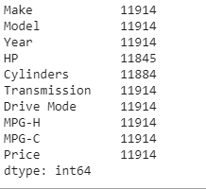
Exploratory Data Analysis(EDA)
data exploring:
6. Dropping the duplicate rows
Procedure:
First finding the no of rows & columns.
df.shape
(11914, 10)
df.count() # Used to count the number of rows
there are 11914 rows

Slide 15
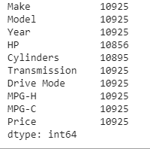
Exploratory Data Analysis(EDA)
data exploring:
Finding no of duplicate data.
duplicate_rows_df = df[df.duplicated()]
print("number of duplicate rows: ",
duplicate_rows_df.shape)
number of duplicate rows: (989, 10)
removing 989 rows of duplicate data
df = df.drop_duplicates()
df.count() # Used to count the number of rows

Slide 16
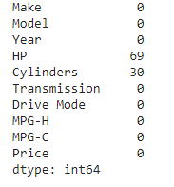
Exploratory Data Analysis(EDA)
data exploring:
7. Dropping the missing or null values.
replace the missing values with the mean or the average of that column.
print(df.isnull().sum())
but in this case drop the missing values. This is because there is nearly 100 missing value compared to 10, 000 values this is a small number and this is negligible. so just dropped those values.
This is the reason in the above step while counting both Cylinders and Horsepower (HP) had 10856 and 10895 over 10925 rows

Slide 17
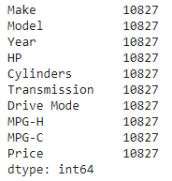
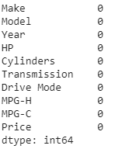
Exploratory Data Analysis(EDA)
data exploring:
df = df.dropna() # Dropping the missing values.
df.count()
Now we have removed all the rows which contain the Null or N/A values (Cylinders and Horsepower (HP)).
print(df.isnull().sum()) # After dropping the values

Slide 18
Exploratory Data Analysis(EDA)
data exploring:
8. Detecting Outliers
An outlier is a point or set of points that are different from other points.
Sometimes they can be very high or very low.
It's often a good idea to detect and remove the outliers. Because outliers are one of the primary reasons for resulting in a less accurate model.
Hence it's a good idea to remove them.
IQR (Inter-Quartile Range) score technique is used to detect and remove outlier.

Slide 19
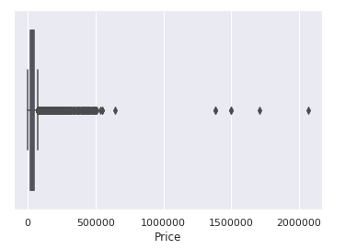
Exploratory Data Analysis(EDA)
data exploring:
outliers can be seen with visualizations using a box plot.
sns.boxplot(x=df['Price'])
Output:
<matplotlib.axes._subplots.AxesSubplot at 0x7f0d36a38be0>

Slide 20
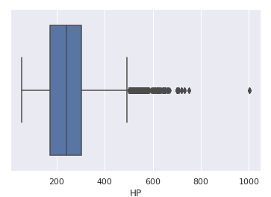
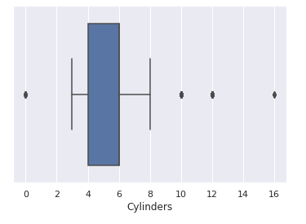
Exploratory Data Analysis(EDA)
data exploring:
sns.boxplot(x=df['HP'])
sns.boxplot(x=df['Cylinders'])
These are the box plot of MSRP, Cylinders, Horsepower and EngineSize.
Herein all the plots, we can find some points are outside the box they are none other than outliers.

Slide 21
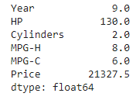
Exploratory Data Analysis(EDA)
data exploring:
Q1 = df.quantile(0.25)
Q3 = df.quantile(0.75)
IQR = Q3 - Q1
print(IQR)
df = df[~((df < (Q1 - 1.5 * IQR)) |(df > (Q3 + 1.5 * IQR))).any(axis=1)]
df.shape
(9191, 10)
As seen above there were around 1600 rows were outliers. But you cannot completely remove the outliers because even after we use the above technique there maybe 1–2 outlier unremoved but that ok because there were more than 100 outliers.

Slide 22
Exploratory Data Analysis(EDA)
data exploring:
9. Plot different features against one another (scatter), against frequency (histogram)
Histogram
Histogram refers to the frequency of occurrence of variables in an interval.
In this case, there are mainly 10 different types of car manufacturing companies, but it is often important to know who has the most number of cars.

Slide 23
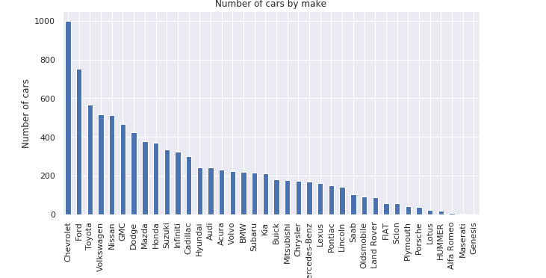
Exploratory Data Analysis(EDA)
data exploring:
histogram is used to know the total number of car manufactured by a different company.
df.Make.value_counts().nlargest(40).plot(kind='bar', figsize=(10,5))
plt.title("Number of cars by make")
plt.ylabel('Number of cars')
plt.xlabel('Make');

Slide 24
Exploratory Data Analysis(EDA)
data exploring:
Heat Maps
Heat Maps is a type of plot which is necessary when we need to find the dependent variables.
One of the best way to find the relationship between the features can be done using heat maps.

Slide 25
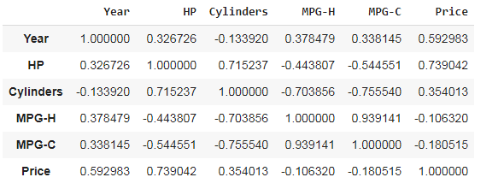
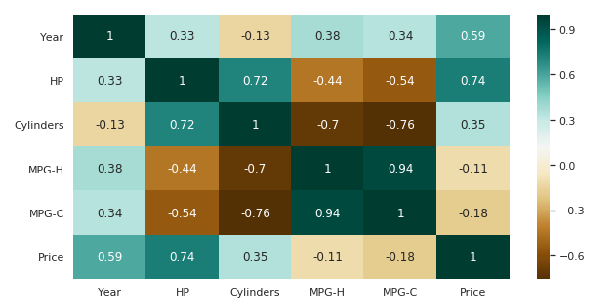
Exploratory Data Analysis(EDA)
data exploring:
Heat Maps
plt.figure(figsize=(10,5))
c= df.corr()
sns.heatmap(c,cmap="BrBG",
annot=True)
C
heat map describes the price
feature depends mainly on the
Engine Size, Horsepower, and
Cylinders.

Slide 26
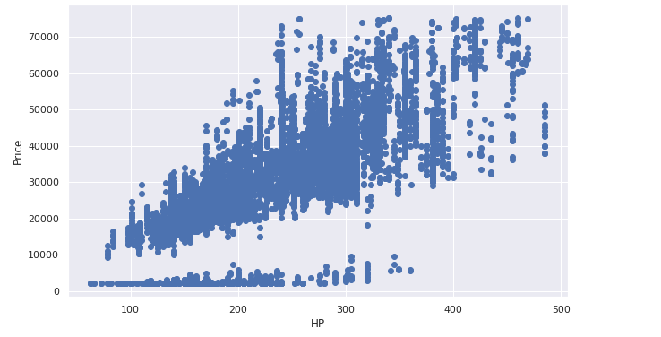
Exploratory Data Analysis(EDA)
data exploring:
Scatterplot
scatter plots are used to find the correlation between two variables.
Here the scatter plots are plotted between Horsepower and Price.
fig, ax = plt.subplots(figsize=(10,6))
ax.scatter(df['HP'], df['Price'])
ax.set_xlabel('HP')
ax.set_ylabel('Price')
plt.show()
With the plot given we can easily draw a trend line.

Slide 27
Exploratory Data Analysis(EDA)
data exploring:
Hence the above are some of the steps involved in Exploratory data analysis, these are some general steps that must follow in order to perform EDA.

Slide 28
Thank You

